Slide 1
IST 718
Final Project
_____________________________________________________________
Advanced Information Analytics
Gauri Komawar
Ishani Jariwala
Sayli Dhuri
Shashank Arora

Slide 2
Introduction
Credit card data for 6 months
Default payments
Demographics
Payment history
Billing statements
Credit data
Consists of 25 variables

Slide 3
Sample row of data
sda
Limit_Bal: Credit Limit
Sex: Gender (1- Male, 2 - Female)
Marriage: Marital Status (1 - Married, 2- Single, 3 - Others)
Education: (1 - Grad, 2 - University, 3 - High School, 4 - Others, 5 - Unknown)
PAY_0 - PAY_6: Repayment Status (-1 - Pay duly, 1 - Payment delay for one month and so on)
BILL_AMT1 - BILL_AMT6: Bill Statement Amount (Sept, 2005 - April, 2005)
PAY_AMT1 - PAY_AMT6: Payment Amount (Sept, 2005 - April, 2005)
Default Payment Next Month: Default Payment (1 - Yes, 0 - No)

Slide 4
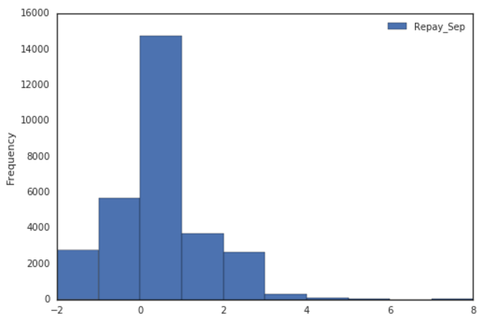
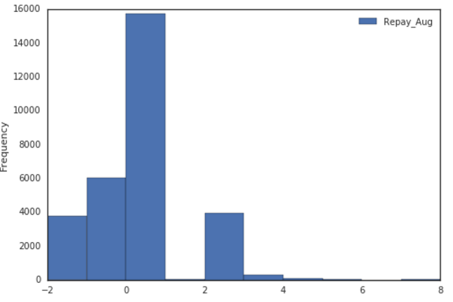
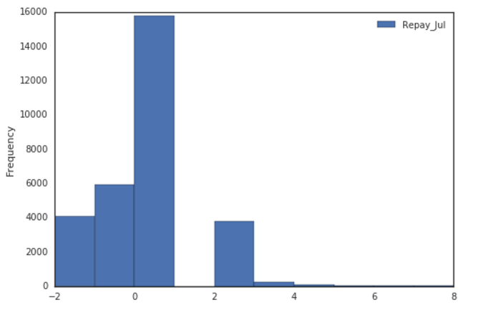
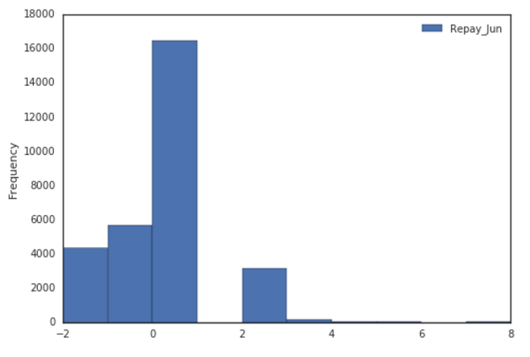
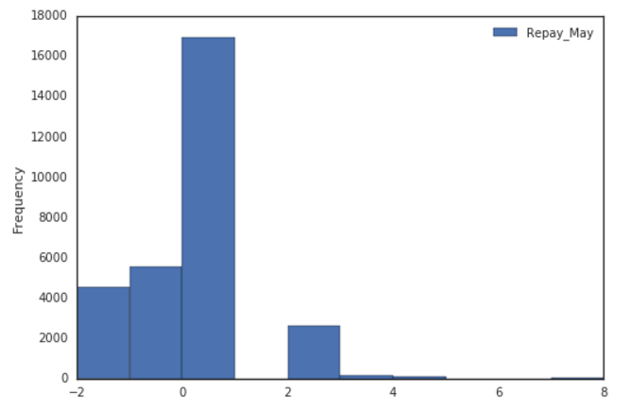
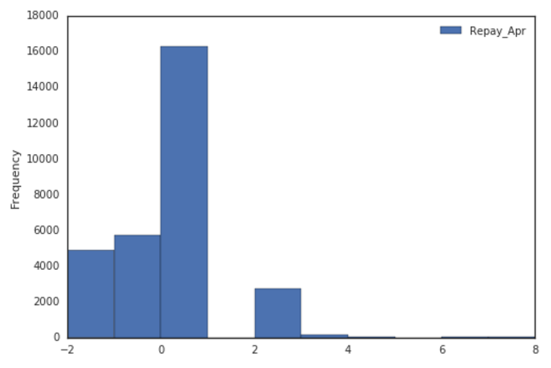
Data Exploration (Repayment Status)

Slide 5
DEMO

Slide 6
Thank You!

Slide 7
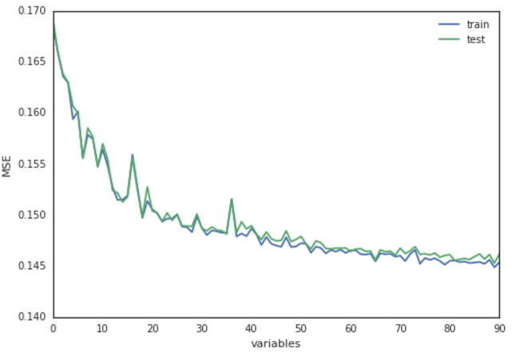
Features VS MSE

Slide 8
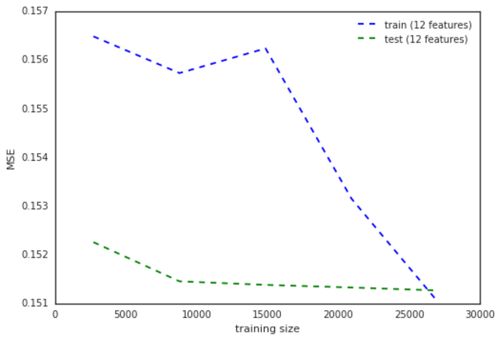
Right Sizing Training Data

Slide 9
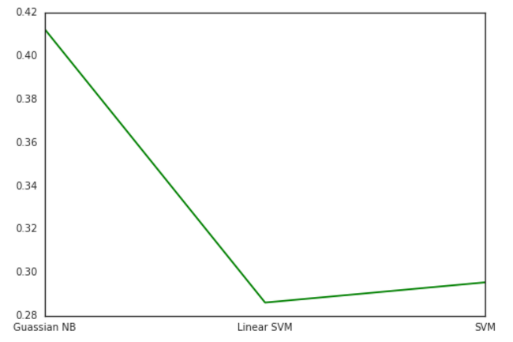
Comparing Different Algorithm w.r.t MSE

